Slide 1
AArete Project: Rising Cancer Incidence in Iowa
Caroline Brincks, Jakob Holcomb, Kyree Sisk, Matthew Riedl

Slide 2
Agenda
Objective of Analysis
Assumptions and Challenges
Methodology
Results
Recommendations
Takeaways

Slide 3
Objective of Analysis
Identify key factors contributing to cancer incidence
Model factor correlation to each cancer type
Explain correlations using demographic data
Create recommendations for AArete

Slide 4
Assumptions & Challenges
Assumptions
Challenges Faced
Lower healthcare access
Exposure to common risk factors
Smoking prevalence
Agricultural pesticides
Behavioral factors
Availability of data consistent over time periods
Large scope of data analysis (risk factor and behavior choices)
Distinguishing between factors respondent to a cancer diagnosis vs. potentially contributing to a diagnosis

Slide 5
Hypothesis
The increasing incidence rates of lung cancer, breast cancer, prostate cancer, and melanoma of the skin in Iowa are respondent to the prevalence of health-related risk factors - such as cholesterol levels and family health history - and engagement in risky behaviors - such as smoking and binge drinking. The upward trend in incidence is further exacerbated by reduced access to preventative healthcare and health education, especially in rural counties.

Slide 6
Methodology

Slide 7
What are "risk factors?"
Health factors correlated with a positive cancer diagnosis in EDA
Factors considered:
High cholesterol
High blood pressure
Obesity (BMI>30)
Factors ignored:
Depression
Sleep apnea/insomnia post-diagnosis

Slide 8
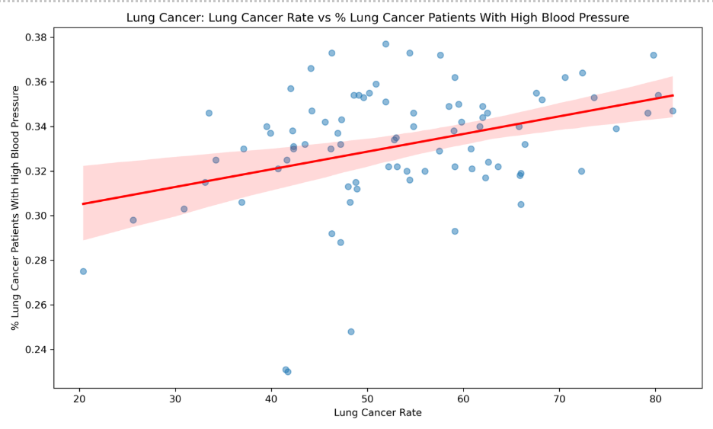
Key Risk Factor: High Blood Pressure
Positive correlation examples were found for other analyzed cancer types as well.

Slide 9
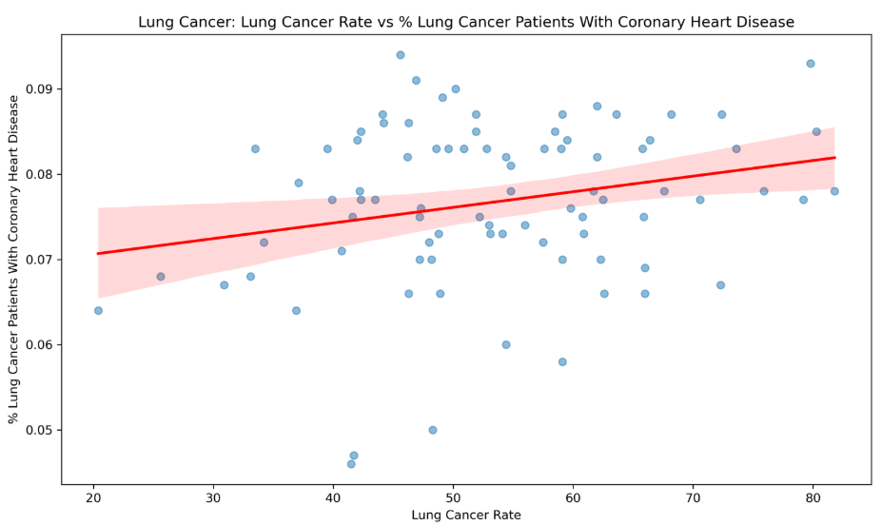
Key Risk Factor: Coronary Heart Disease
Positive correlation examples were found for other analyzed cancer types as well.

Slide 10
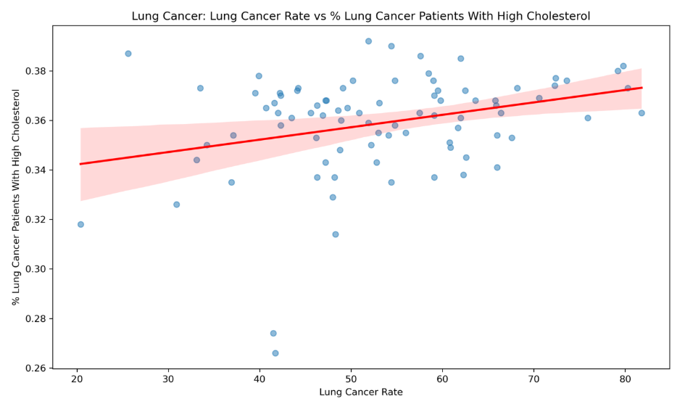
Key Risk Factor: High Cholesterol
Shown to support cancer cell survival (3); positive correlation examples were found for other analyzed cancer types as well.

Slide 11
What are "risky behaviors?"
Behaviors that contribute to development of cancer risk factors in EDA
Factors considered:
Smoking
Binge drinking
Daily physical inactivity (<3000 steps per day)

Slide 12
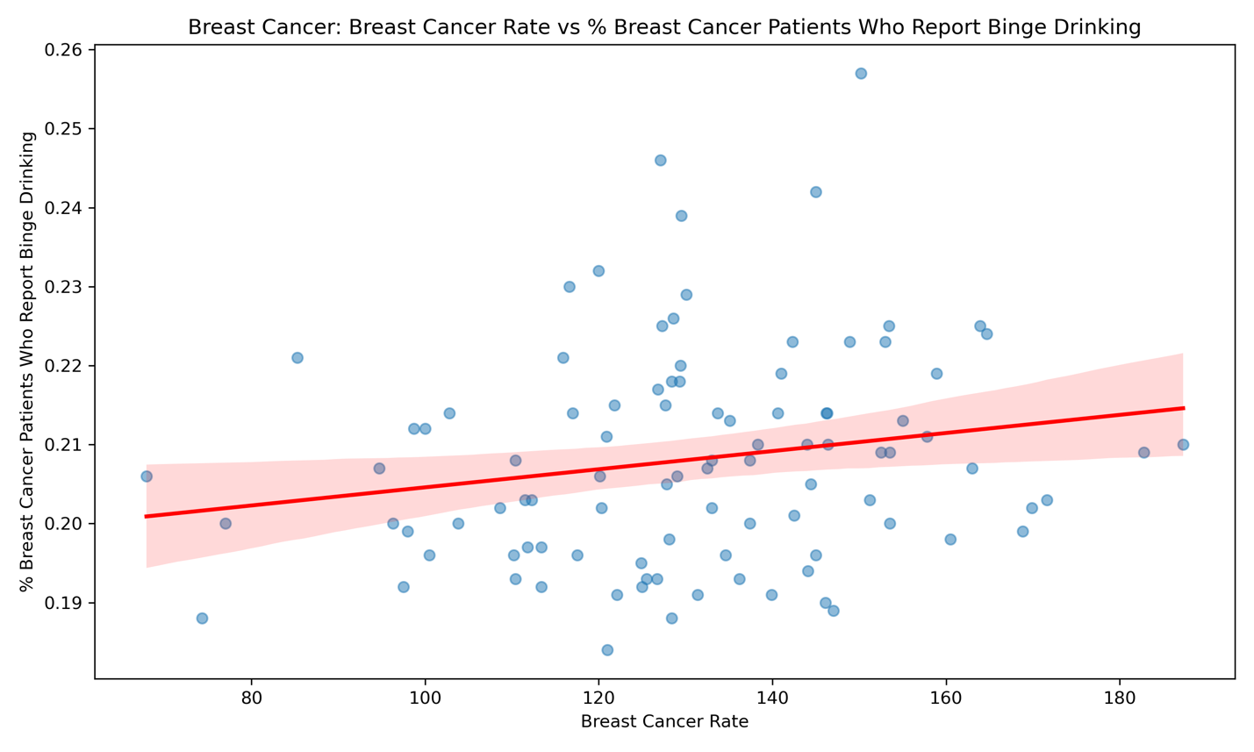
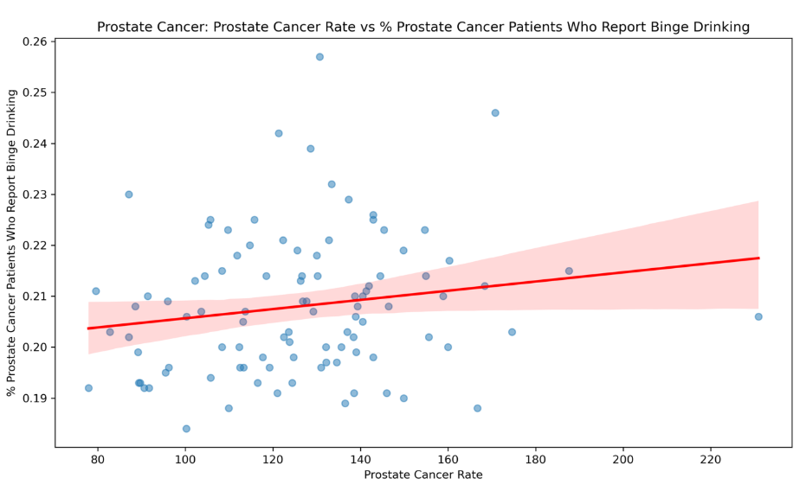
Key Risky Behavior: Binge Drinking
Iowa Cancer Registry: binge drinking is a leading preventable cause of cancer in Iowa (1); our analysis confirmed positive correlation for every cancer type

Slide 13
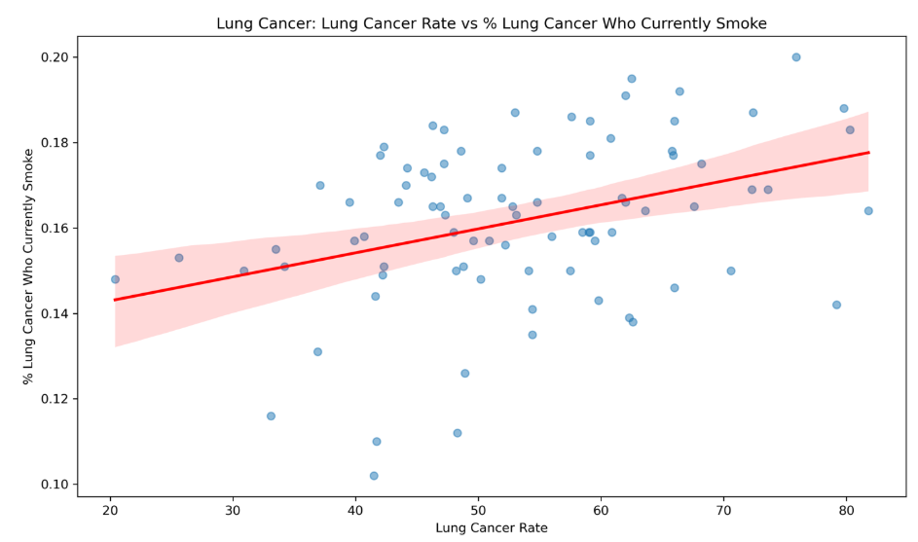
Key Risky Behavior: Smoking
Positive correlation examples were found for other analyzed cancer types as well.

Slide 14
Other factors in our data
Demographic factors that help explain risk trends
Factors considered:
Population by county
Education level counts by county
Count of citizens without health insurance
Count of citizens receiving unemployment benefits
Factors ignored:
Count of citizens identifying with one of six racial categories
Alaskan Native/American Indian, AAPI, Hispanic, African American, White, foreign-born

Slide 15
Data & Results

Slide 16
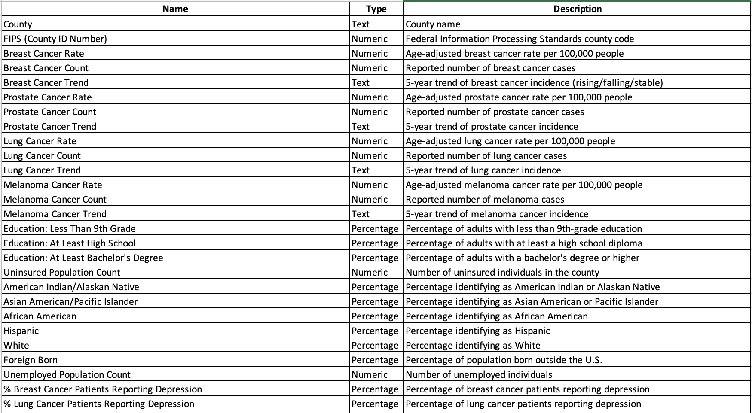
Data Breakdown

Slide 17
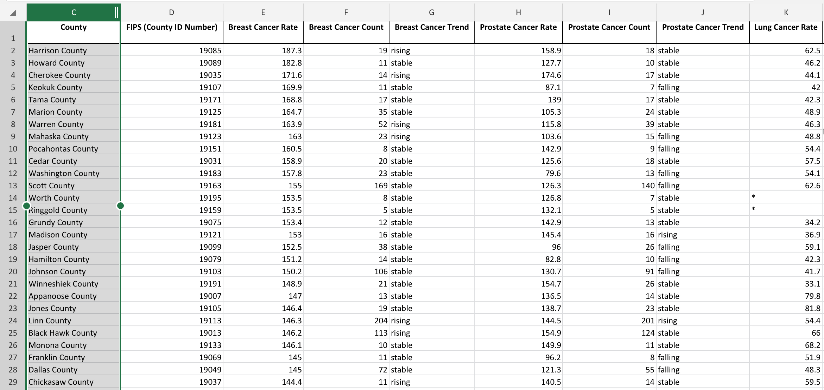

Slide 18
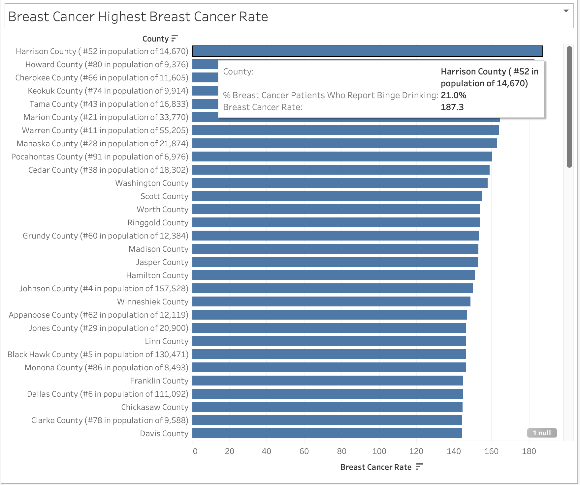
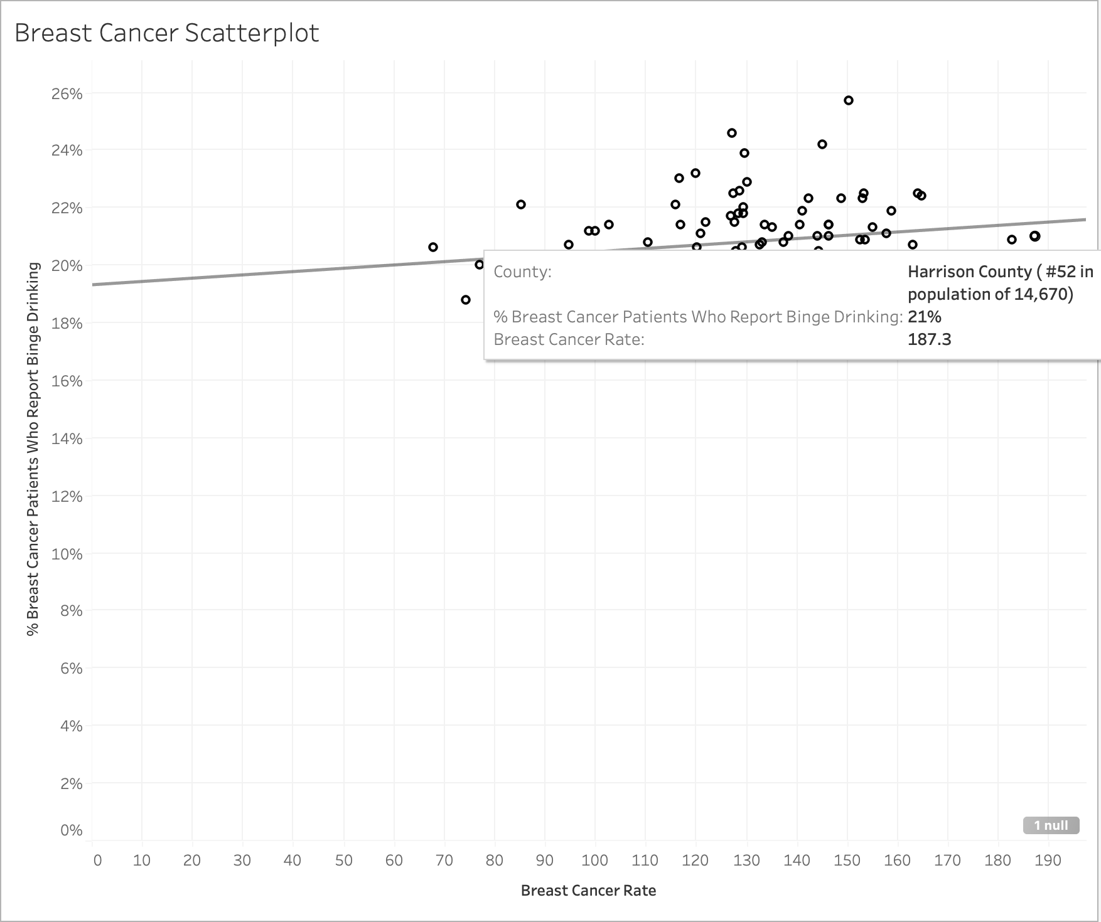
Breast Cancer & Binge Drinking

Slide 19
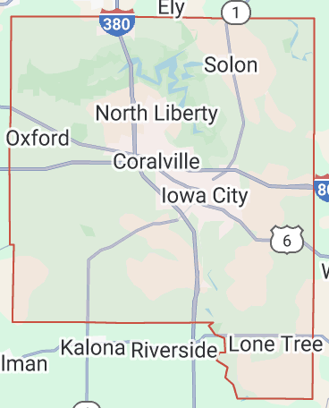
County Outliers
Johnson County
25.7% of breast cancer patients report binge drinking
Breast Cancer rate: 150.2
Home of Iowa City
4th highest population

Slide 20
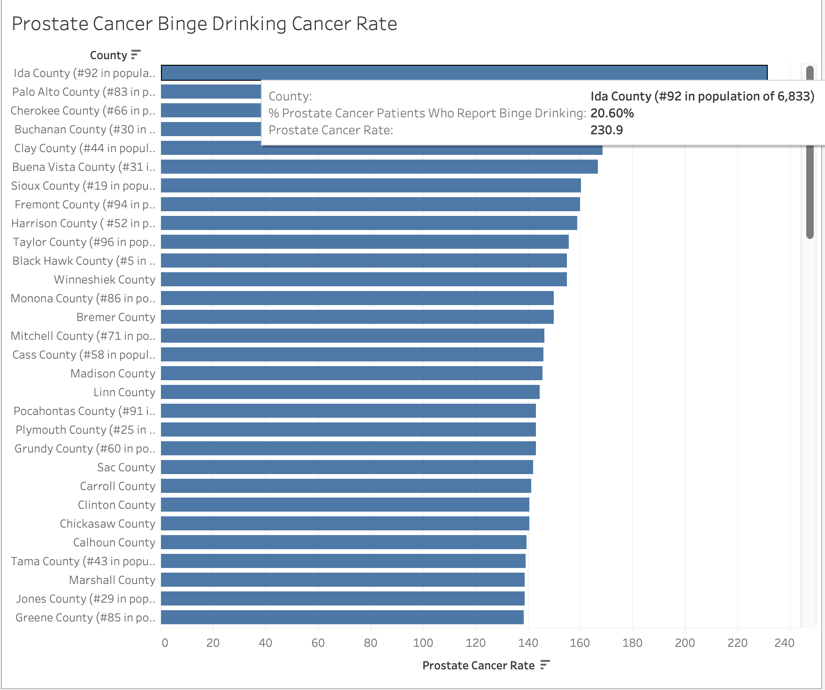
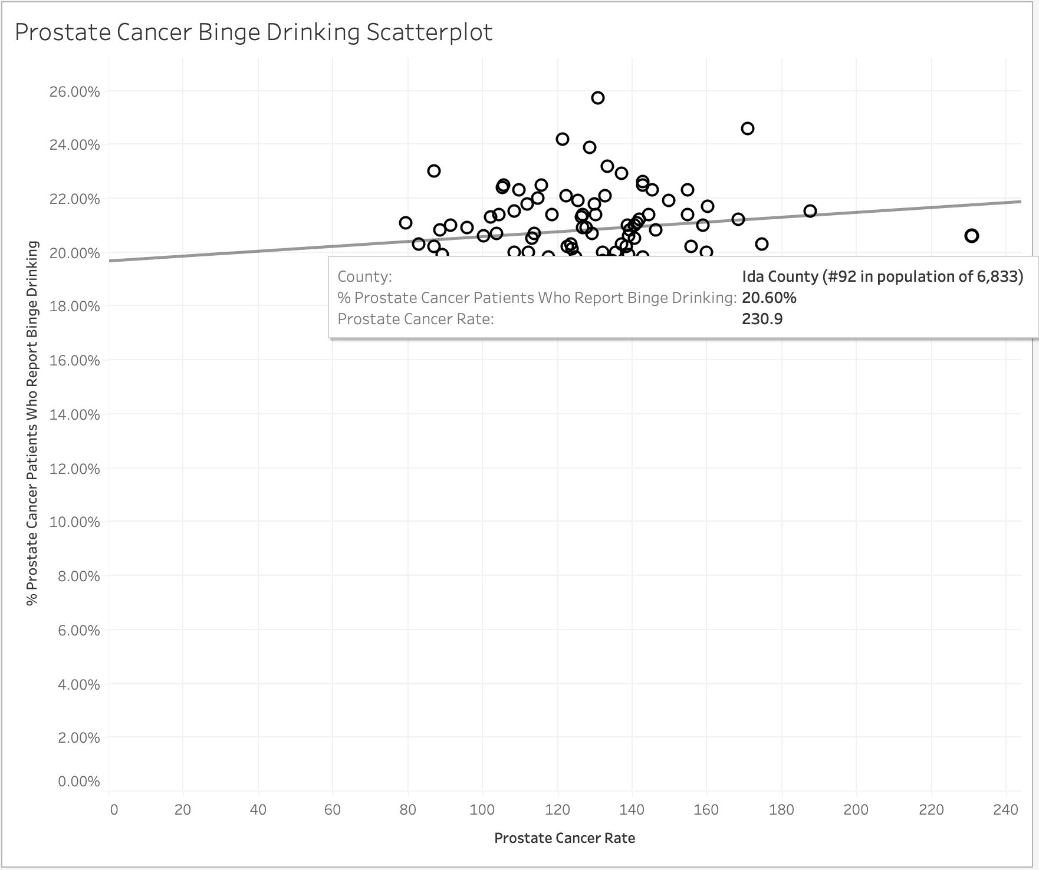
Prostate Cancer & Binge Drinking

Slide 21
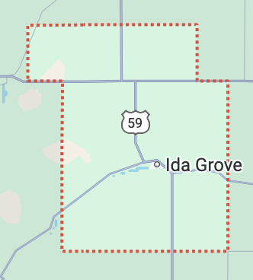
County Outliers
Johnson
Middle pack Prostate Cancer rate: 130.7
Very high Binge drinking rate
Home of Iowa City
4th highest population
Ida
Extremely high Prostate Cancer rate: 230.9
7th smallest county by population
Rural town Iowa

Slide 22
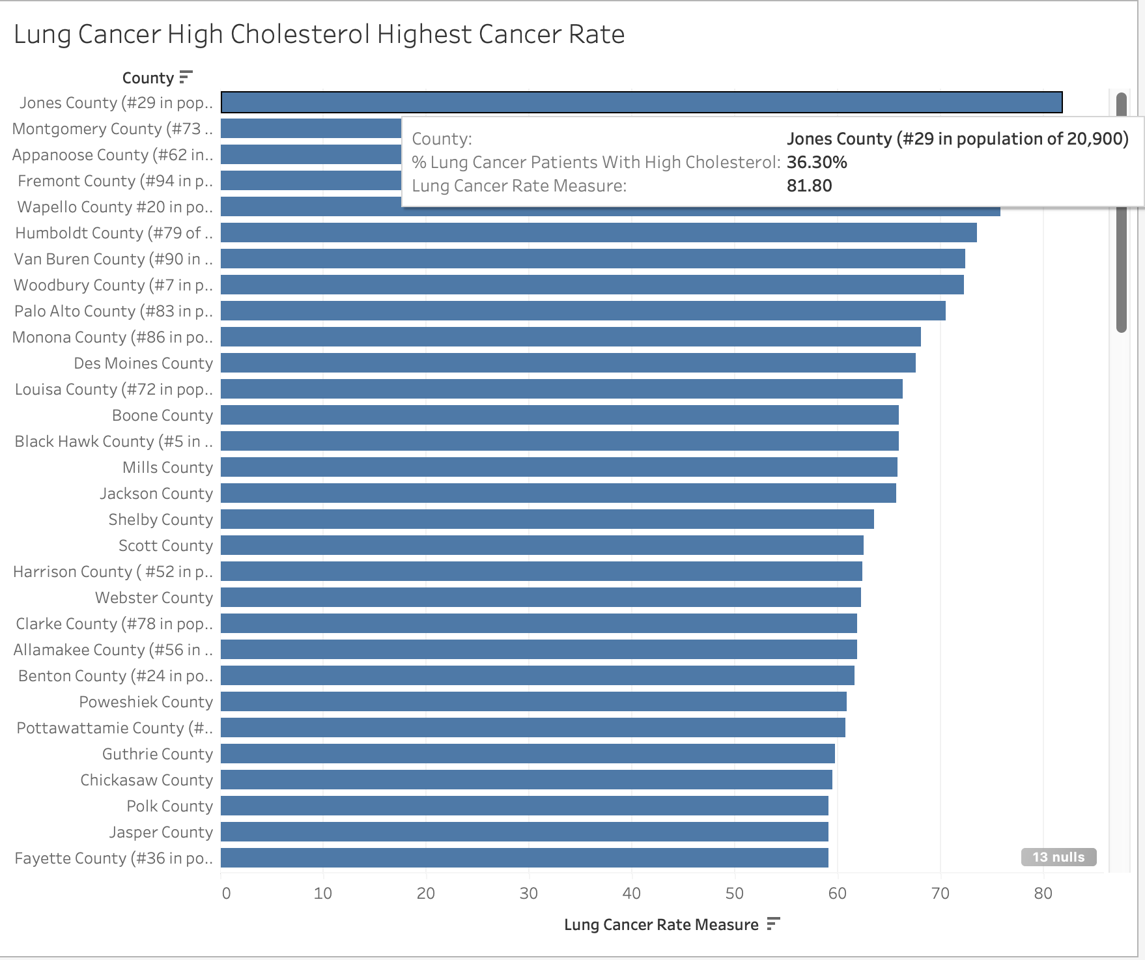
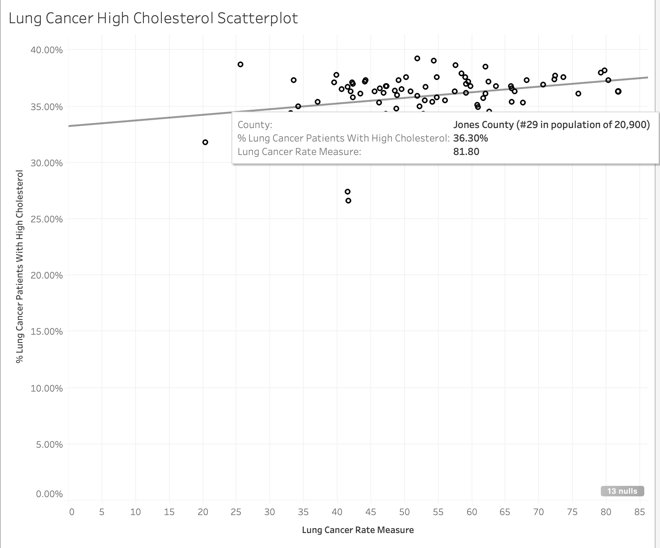
Lung Cancer & High Cholesterol

Slide 23
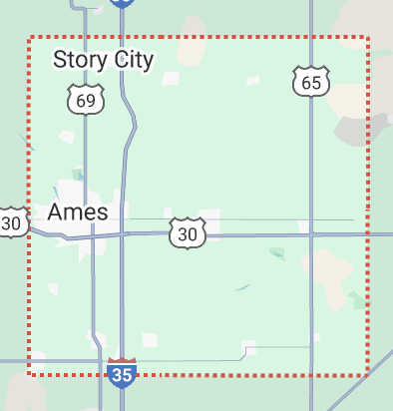
County Outliers
Story
Very low rate of High Cholesterol: 27.4%
Low Lung Cancer rate: 41.5
Ames area
9th highest population
Johnson
Very low rate of High Cholesterol: 26.6%
Low Lung Cancer rate: 41.7
Iowa City area
4th highest population
Both active College towns

Slide 24
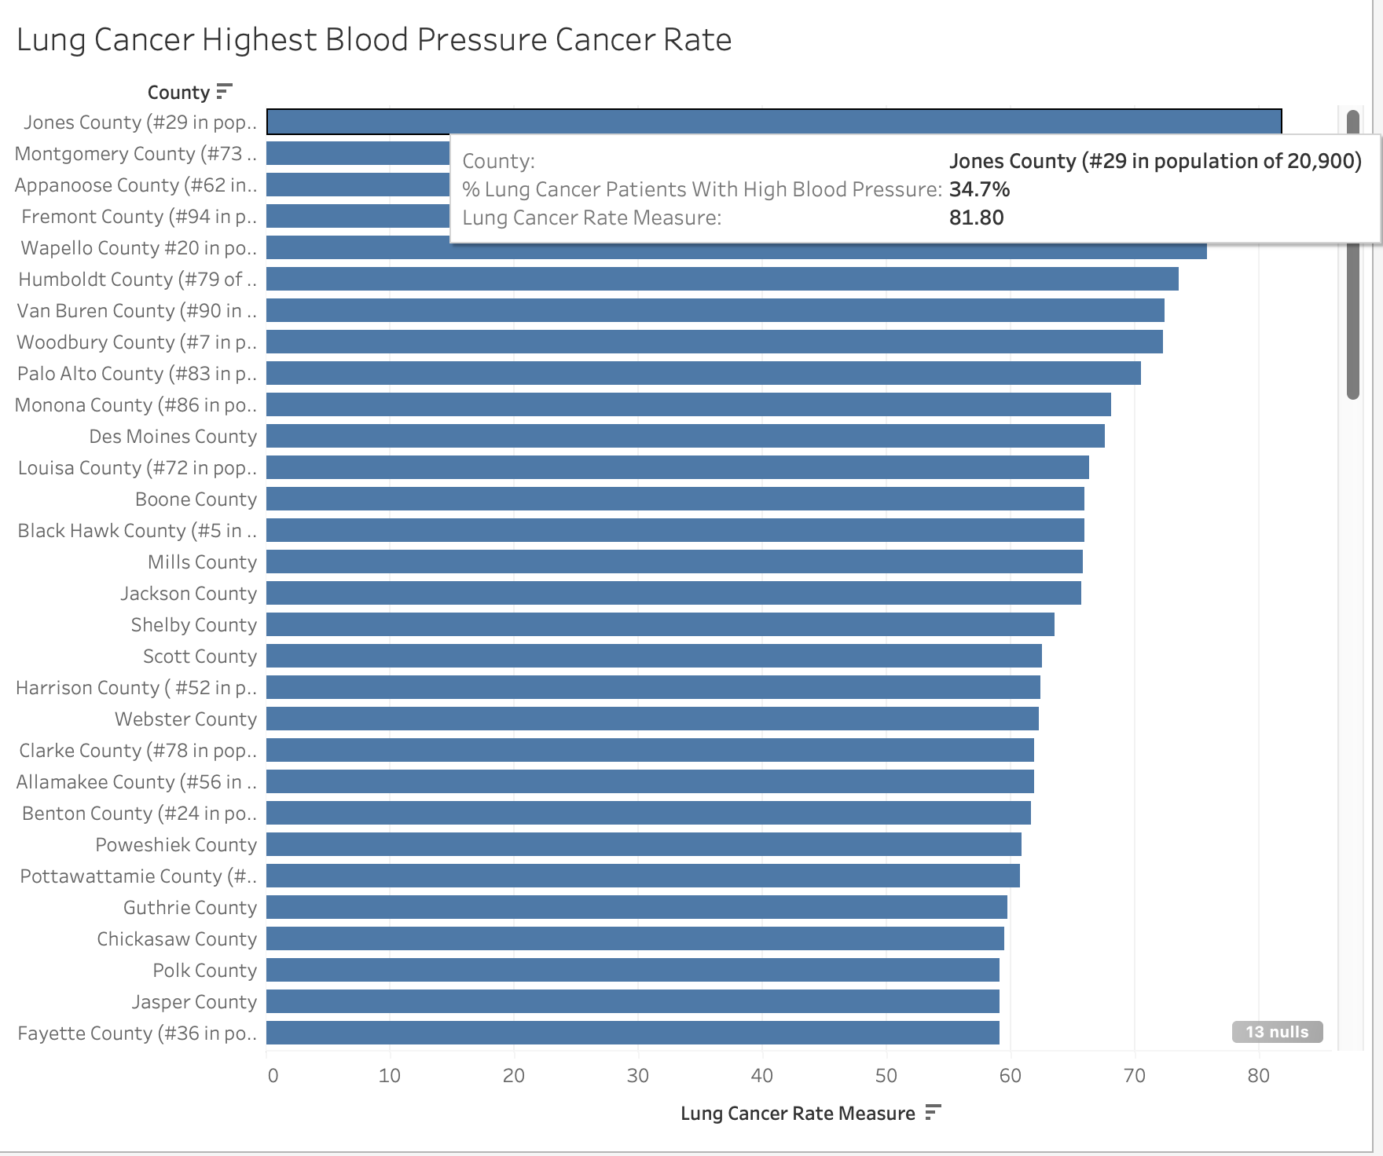
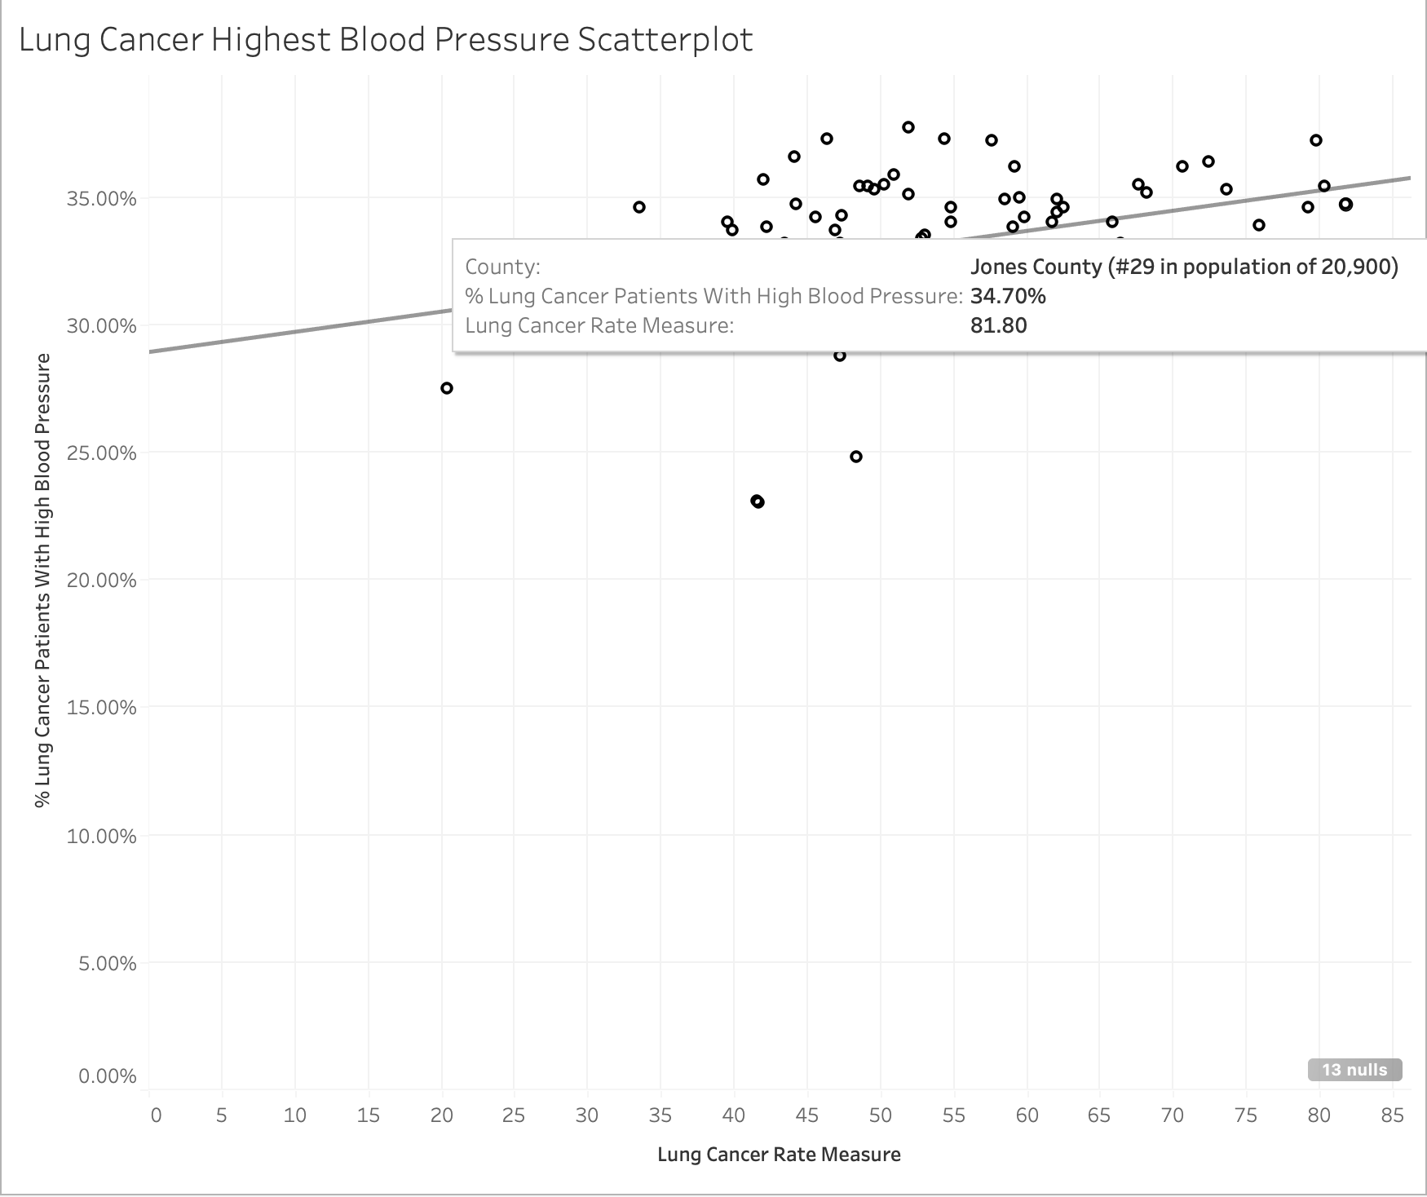
Lung Cancer & High Blood Pressure

Slide 25
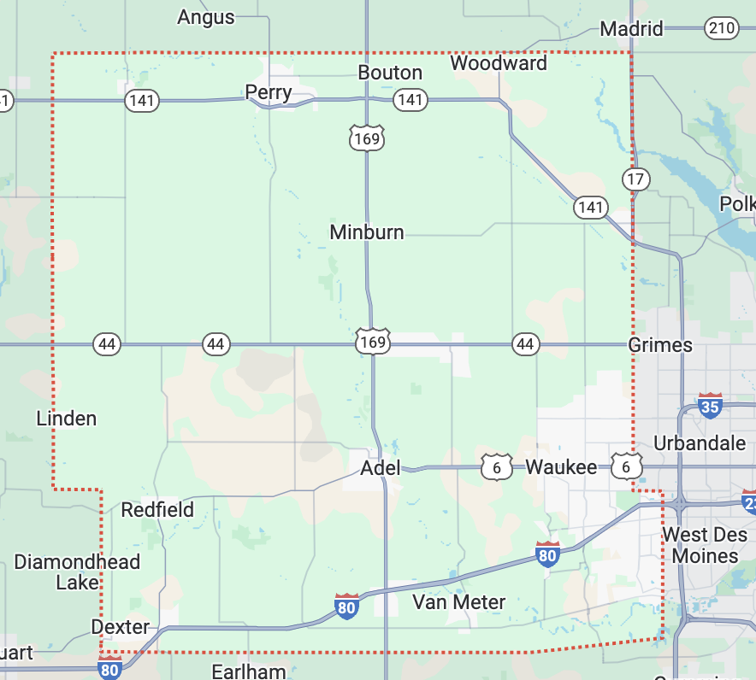
County Outliers
Story
Very low rate of high blood pressure: 23.7%
Low Lung Cancer rate: 41.5
Ames area
9th highest population
Johnson
Very low rate of high blood pressure: 23%
Low Lung Cancer rate: 41.7
Iowa City area
4th highest population
Dallas
Very low rate of high blood pressure: 24.8%
Low Lung Cancer rate: 48.3
West Des Moines area
6th highest population

Slide 26
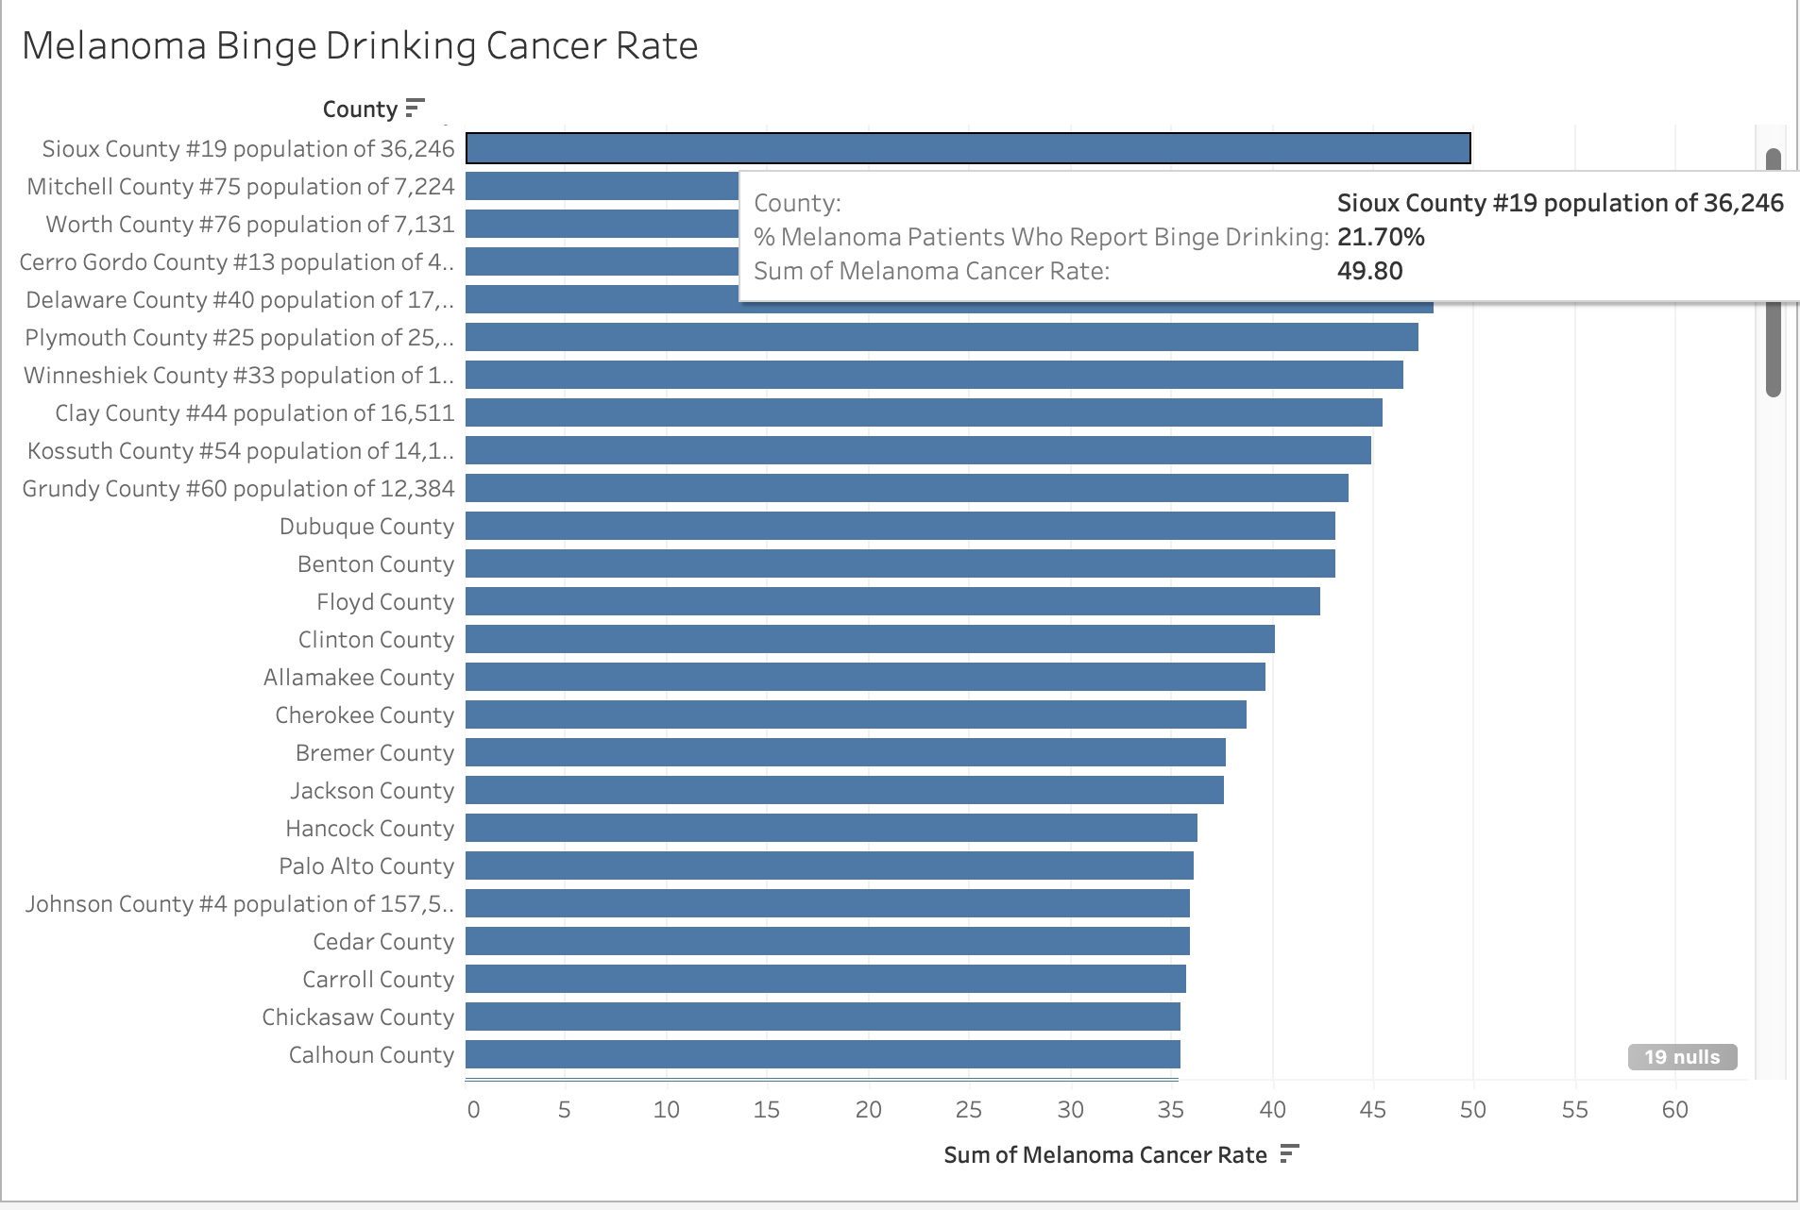
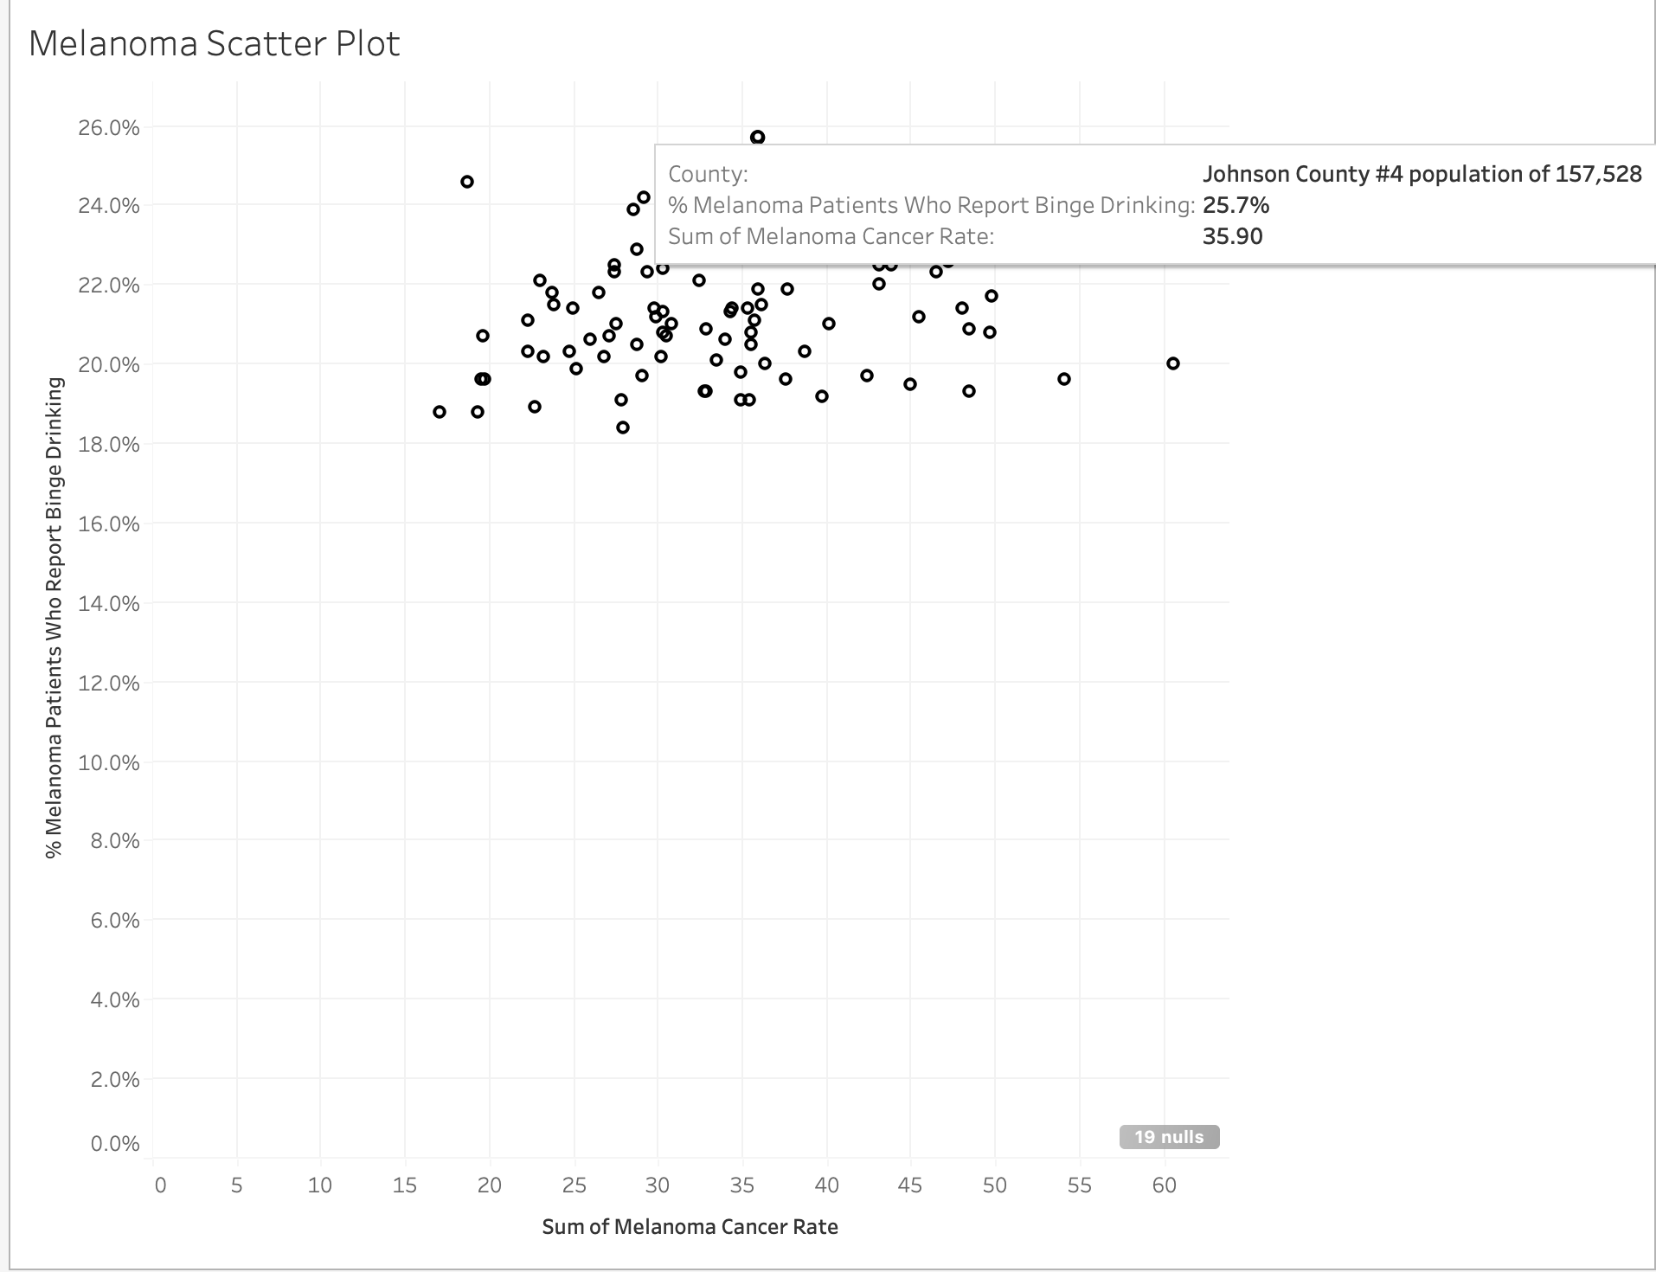
Melanoma Cancer & Binge Drinking

Slide 27
County Outliers
Johnson
Middle pack Prostate Cancer rate
Very high Binge drinking rate
Home of Iowa City
4th highest population

Slide 28
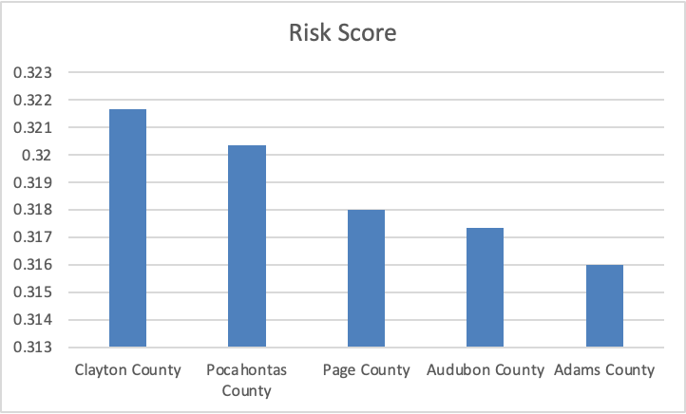
Recommendations for AArete
Targeted Healthcare Resource Allocation
Target rural and high-risk counties
Offer incentives for risky behavior reduction: percent discounts on health insurance policies
What Is health risk?
Rural counties
2023 Rural Urban Continuum Codes
Average frequency of binge drinking, high cholesterol, high blood pressure

Slide 29
Estimated Insurance Costs
Insurance Premium Costs With and Without Discount
Coverage Type | Original Annual Premium | 10% Discount | Discounted Premium
Single Coverage | $8,435 | $843.50 | $7,591.50
Family Coverage | $23,968 | $2,396.80 | $21,571.20
Example: Offering Discount to 1,000 High-Risk Individuals
Scenario | Total Cost (No Discount) | Total Cost (With 10% Discount) | Annual Cost Savings to Insurer
1,000 people (Single Coverage) | $8.435 million | $7.591 million | ~$844,000
1,000 people (Family Coverage) | $23.968 million | $21.571 million | ~$2.397 million

Slide 30
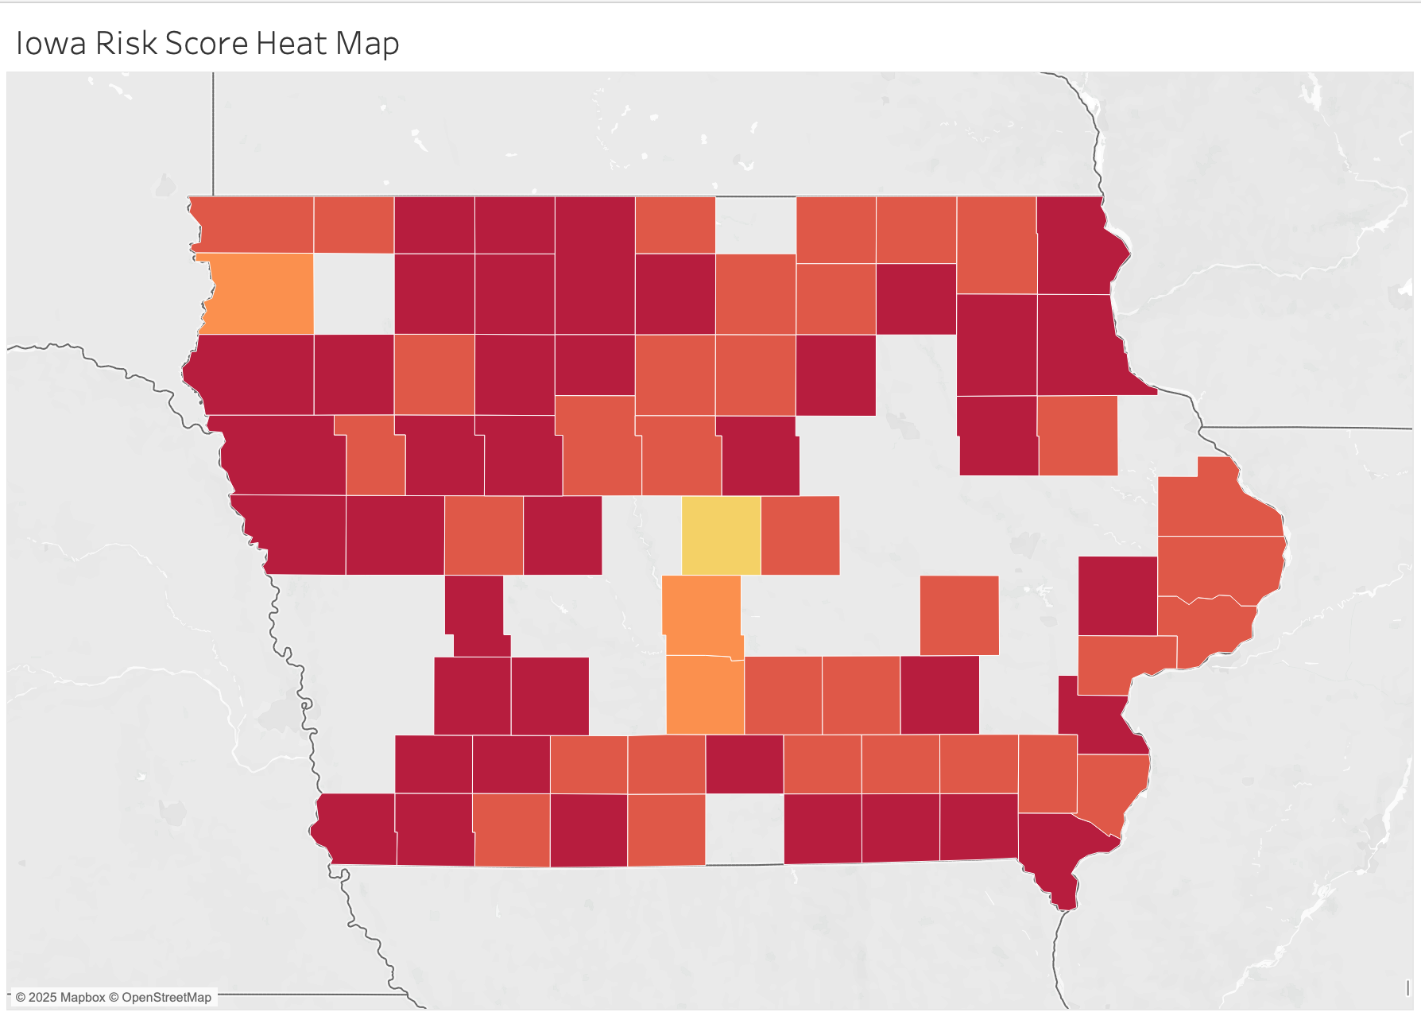
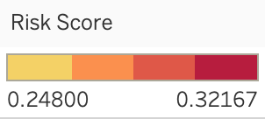
Recommendations for AArete
Health Engagement Strategy
Local TV Campaign
30 seconds
$1500 - $3500
Tracking Effectiveness
Total TV viewers
Track site views
Sign-ups

Slide 31

Team Takeaways
Interdisciplinary Thinking Connected data skills with public health and social context to go beyond surface-level analysis.
Technical & Team Growth Built strengths in analysis, visualization, and collaboration.
Data-Driven Storytelling Learned how structured data reveals meaningful trends in Iowa communities.
Real-World Impact Gained insight into how consulting firms like AArete drive health and economic outcomes.

Slide 32
Sources
https://www.hhs.gov/sites/default/files/oash-alcohol-cancer-risk.pdf (1)
https://pmc.ncbi.nlm.nih.gov/articles/PMC9222904/ (2)
https://www.frontiersin.org/journals/immunology/articles/10.3389/fimmu.2022.1057546/full (3)
Iowa | County Health Rankings & Roadmaps (4)
Iowa’s Healthcare Landscape (5)
Iowa Legislature - BillBook (6)
https://www.creativehumans.com/ (7)
https://www.tvscientific.com/ (8)
https://www.kff.org/report-section/ehbs-2023-section-1-cost-of-health-insurance/?utm_source (9)

